Slide 1
Writing Workshop
OUC
Class 4

Slide 2
Class Objectives
Review Sentence Structures
Grammar
Relative Clause
Verb Tenses & Aspect
Exercise: Review Writing Samples
Verbal Practice
Listening Practice

Slide 3
Simple Sentence
A sentence formed by ONE independent clause
Compound Sentence
A sentence formed by TWO OR MORE independent clauses and JOINED by a CONJUNCTION
Complex Sentence
A sentence formed by joining ONE independent clause with
ONE OR MORE dependent clauses
Compound-Complex Sentence
A sentence formed by joining TWO OR MORE independent clauses with
ONE OR MORE dependent clauses

Slide 4
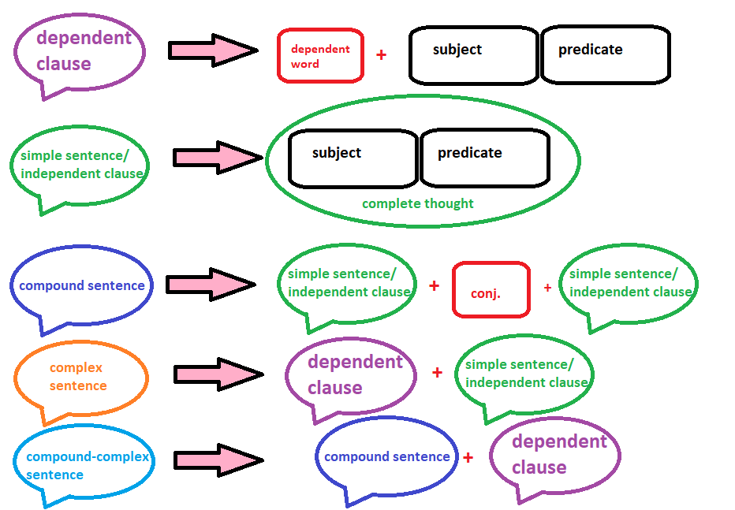
Recap

Slide 5
Independent vs Dependent Clauses
Independent Clause (aka Simple Sentence)
Subject + Predicate = Complete Idea
Can be understood with no extra information
CAN stand alone as a sentence
Dependent Clause
Subject + Predicate =/= Complete Ideal
Gives background information but CANNOT stand alone (in formal American English)
MUST be attached to an independent clause
Usually signaled by a dependent word (typically a subordinating conjunction)
Can act as a noun, adjective, or adverb
Again, this is an advanced part of English grammar and something that many native English speakers confuse often. It’s OK if you have difficultly parsing an independent from a dependent clause. You just have to practice breaking down sentences over and over again until it becomes second nature! ☺

Slide 6
Relative Clause
Type of DEPENDENT CLAUSE
Starts with a RELATIVE PRONOUN
Substitutes a noun
Examples: who, that, which, whose, where
Most often used to identify or modify the proceeding noun
Can be used to improve the style of your writing and better convey large amounts of information.
Avoid using the same sentence structure over and over again
Let’s dissect this sentence:
“We need to find a store that sells mint chocolate chip ice cream.”
Identify the independent and relative clauses
Identify the relative pronoun, what noun is it replacing?
What part of speech does the relative clause function as?

Slide 7
Relative Clause
Type of DEPENDENT CLAUSE
Starts with a RELATIVE PRONOUN
Substitutes a noun
Examples: who, that, which, whose, where
Let’s dissect this sentence:
We need to find a store that sells mint chocolate chip ice cream.
relative pronoun of “store”
adj. relative clause

Slide 8
Verb Tenses ~TIME TRAVEL~ that allows you to fine tune what you are trying to communicate
The 4 Past Tenses | Example | Purpose
simple past tense | I went | describe a completed activity that happened in the past
past progressive tense | I was going | describe an on-going activity in the past; often, it is used to set the scene for another action
past perfect tense | I had gone | emphasize that an action was completed before another took place
past perfect progressive tense | I had been going | show that an on-going action in the past has ended
The 4 Present Tenses
simple present tense | I go | describe an activity happening currently; mostly used to describe facts and habits
present progressive tense | I am going | used for an on-going action in the present
present perfect tense | I have gone | used for actions began in the past that are continuing in the present
present perfect progressive tense | I have been going | used for a continuous activity that began in the past and continues into the present (or has very recently ended)
The 4 Future Tenses
simple future tense | I will go | used for an action that will occur in the future
future progressive tense | I will be going | used for an on-going action that will occur in the future
future perfect tense | I will have gone | used to describe an action that will have been completed at some point in the future
future perfect progressive tense | I will have been going | used for an on-going action that will be completed at some specified time in the future

Slide 9
Exercise: Review & Edit Writing Sample
With the development of technology, a variety of problems have been rose around us today. There is no doubt that our daily life is becoming convenient and enjoyable because of the upgrading of the technology. Nevertheless, we may worry about that we become too lazy to solve the problems by relying on the machines rather than doing by ourselves. In my opinions, I still believe in that technology can bring more positive impact than the negative impact about the technology.

Slide 10
Exercise: Review & Edit Writing Sample
With the development of technology, a variety of problems have been rose around us today. There is no doubt that our daily life is becoming convenient and enjoyable because of the upgrading of the technology. Nevertheless, we may worry about that we become too lazy to solve the problems by relying on the machines rather than doing by ourselves. In my opinions, I still believe in that technology can bring more positive impact than the negative impact about the technology.

Slide 11
Exercise: Review & Edit Writing Sample
Revision:
A variety of problems have arisen around us today with the development of technology. Because of the upgrading of the technology, there is no doubt that our daily lives are becoming more convenient and enjoyable. Nevertheless, we may worry that we are becoming too reliant on machines and too lazy to solve our own problems. In my opinion, I still believe in that the positive impact of technology will outweigh the negative impact of the technology.

Slide 12
Exercise: Review & Edit Writing Sample
Re-write:
The advent and advancement of technology has ushered in a host of new and unprecedented problems for its human creators. There is no doubt that daily life has become more convenient and more enjoyable as a result of this technology revolution, but these rapid changes may have unforeseen and unintended consequences on our society. There is growing concern that people have become too reliant on technology to solve their problems. Nonetheless, I believe that the positive impacts of technology still outweigh the negative ones.

Slide 13
Verbal practice

Slide 14
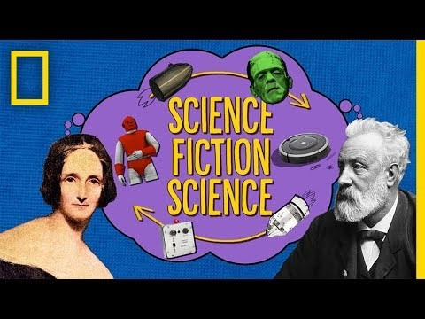
Listening Practice!
https://youtu.be/IAZAIdLwhGw

